Slide 1
03. Storage in cloud

Slide 2
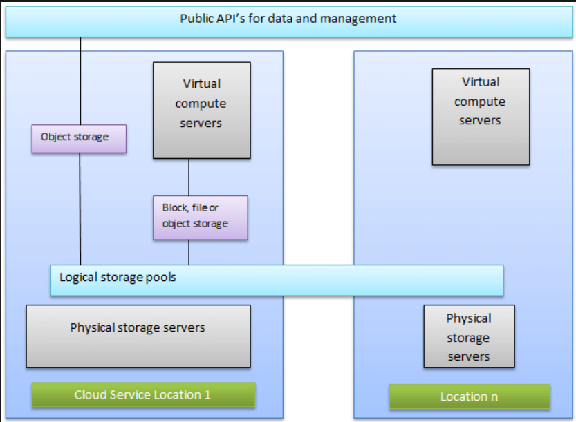
Storage System Architecture : -
i) The design and arrangement of data storage resources & services inside a cloud computing environment is storage system architecture.
ii) It manages and stores a lot of data, necessitating specialized solutions with higher dependability & manageability.

Slide 3
1. Public API is for Data and Management : - Public APIs allow users and applications to interact with, manage, and access stored data programmatically through standardized interfaces.
2. Virtualized Compute server : - A Virtualized compute server enables the allocation of virtual machines to efficiently process. data. It performs compute task while interacting
with storage.
3. Object storage : - Object storage organizes data into objects, each containing the data itself, metadata, and a unique identifier, making it ideal for unstructured data. It provides scalable and cost - effective storage with easy retrieval.
4. Block storage : - Block storage divides data into fixed - size blocks, each managed separately, offering high - performance storage.
5. File/object storage : - File storage organizes data in hierarchical file system, making it suitable for shared access, object storage on the other hand stores data as discrete objects with metadata and unique identifiers.
6. Logical storage Pool : - A logical storage pool is an abstrackted collection of physical storage resources, unified into a single entity. It enables dynamic allocation & scaling of storage capacity without direct interaction with the underlying hardware.
7. Physical storage Server : - A physical storage server is the hardware infrastructure where data is physically stored such as harddrivers in data centers.
8. Cloud Storage Location : - It represents different geographical locations where cloud provider's store data. The choice of service location affects service latency, availability, etc…

Slide 4
Virtualized data center (vdc) : -
A Virtualized Data Center (VDC) refers to a data center where the physical infrastructure is abstracted or virtualized into logical units using software.
Physical resources like CPU, memory and storage are pooled together and allocated dynamically to virtual machines based on demand. (Resource Pooling).
By running multiple VMs on a single physical server, the hardware is utilized while reducing the need for excess physical infrastructure.
VDC is a type of Infrastructure-as-a-Service (IAAS), where a cloud provider delivers storage, applications, networking components and computing on demand."

Slide 5
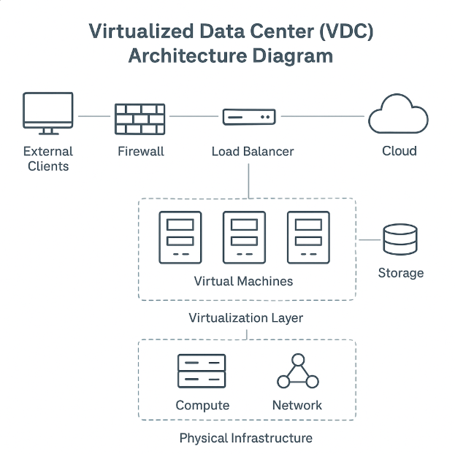
Vdc architecture : -
It is a framework that facilitates the deployment and management of virtual resources within a data center.
A Virtualized Data Center (VDC) Architecture is a logical framework that integrates physical IT resources such as servers, storage, and networking into a virtualized environment to deliver computing resources as services.
It abstracts, pools, and manages these resources virtualization and cloud management technologies.
There are four phases to achieve VDC : -
Phase 1 : Virtualized Infrastructure.
Phase 2 : Virtualized compute.
Phase 3: Virtualized Network.
Phase 4 : Virtualized storage.

Slide 6
Vdc environment : -
Provides a flexible, scalable and dynamic environment for hosting applications.
A Virtual Data Center (VDC) Environment is a complete IT setup where computing, storage, and networking resources are virtualized, pooled, and delivered as services through a centralized management system.
It acts like a software-defined version of a traditional data center.
Components of VDC environment : -
Hypervisor - Controls VMs and manages resource allocation.
Virtual Network - Allow seamless communication between VMS
Storage Virtualization - Pooling storage for easier management.

Slide 7
Block & file level storage virtualization : -
Types of storage virtualization : -
Block – level storage virtualization.
File – level storage virtualization.

Slide 8
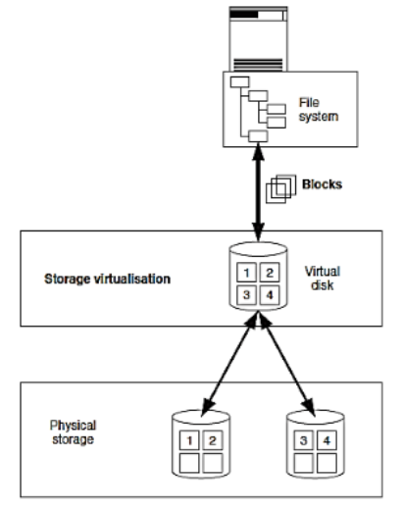
1. block-level storage virtualization : -
It abstracts physical storage into virtual blocks that can be used by any OS or application.
It divides the data into fixed size blocks and storing them on block devices such as hard drives.
Storage can be easily scaled up or down by removing blocks.
Block storage is commonly used for application latency, high performance storage such as databases or virtual machine.

Slide 9
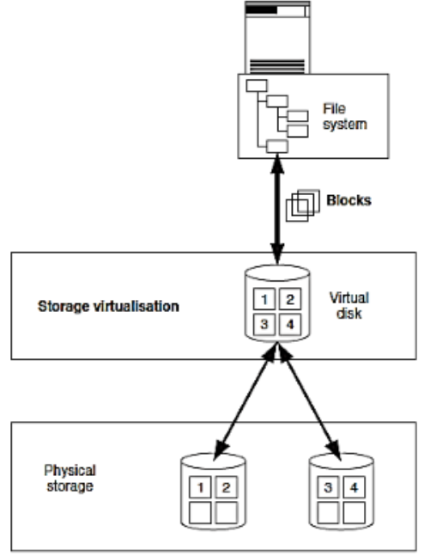
File-level storage virtualization : -
It aggregates file storage across multiple devices into a unified file system.
It stores data as files and present it to the final users as a hierarchical structure.
File storage is more affordable than block storage, especially for storing large amount of unstructured data.
It also creates a logical pool of storage enabling to use a logical path rather than a physical path to access files.

Slide 10
Virtual provisioning : -
It allocates storage on - demand, without needing to pre - allocate the full amount of physical storage.
Virtual Provisioning is also reffered as thin provisioning.
The ability to deliver a LUN (logical Unit Number) to a compute system with more capacity than LUN on the physical storage array is known as virtual provisioning.
It can be used in storage layer and compute layer implementations.

Slide 11
Automated storage tiering : -
It moves data between High-performance (SSD) and lower- performance (HDD) storage tiers based on usage patterns.
Storage tiering prioritizes storage blocks into different categories refferred to as storage Hers.
It is a real-time intelligent mechanism.
It has easy to use GUI based management tools.

Slide 12
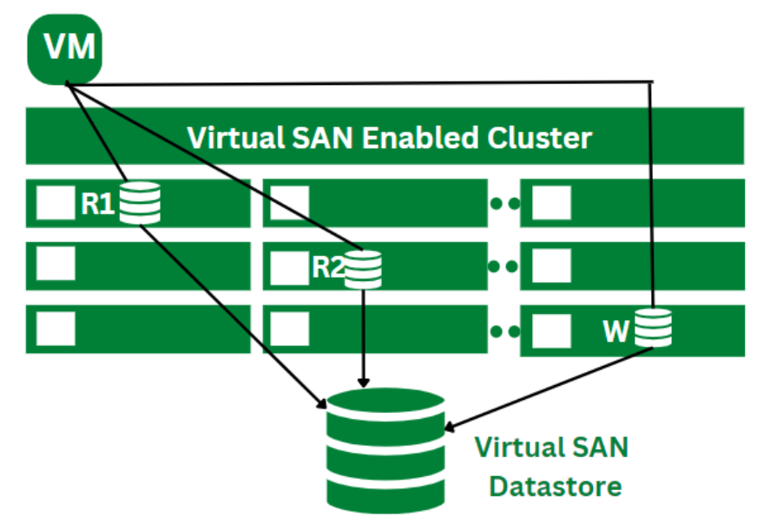
Virtual storage area network (VSAN) : -
VSAN is a software - defined solution that pools physical storage into a virtualized stalable network.
VSAN enable efficient storage management and data isolation across virtual machines.
It enhance performance by pooling storage resources and allow for easy scalability.
They provide secure, flexible storage solutions.
It dynamically allocates storage for VMs according to the requirements.
VSAN is especially well-suited for cloud computing environments.

Slide 13
Benefits : -
1. Cost-Effectiveness : - VSAN does not require physical storage arrays therefore it is less expensive than conventional storage systems.
2. Scalability : - VSAN is well-suited for could computing environment that can be simply scaled to meet changing storage requirements.
3. Increased Performance : - To deliver quick and dependable storage performance, VSAN makes use of high-speed interconnects.
4. Flexibility : - Block and file storage are supported by VSAN, giving clients the option to select the type of storage that best suits their requirements.
5. Data Security : - VSAN has tools that guard against data loss and guarantee that information is always accessible.
6. Simplified Management : - Administration is made easier because of VSAN'S Integration with the VMware vSphere virtualization technology, which offers a single management panel.

Slide 14
Cloud file system : -
A Cloud File System (CFS) is a storage system that allows users and applications to store, manage, and access files over the internet through cloud computing infrastructure instead of using local storage devices.
A cloud file system is a distributed file storage service provided in the cloud that behaves like a traditional file system but is hosted on remote servers managed by cloud providers.
A cloud file system works like your computer’s folder and file storage, but the files actually live on the cloud servers, making them more flexible, secure, and easily accessible.
Examples of cloud file system : -
- Amazon Elastic File System (EFS).
- Google Cloud File store.
- Microsoft Azure Files.
- Dropbox, Google Drive, OneDrive (consumer-level cloud file storage).

Slide 15
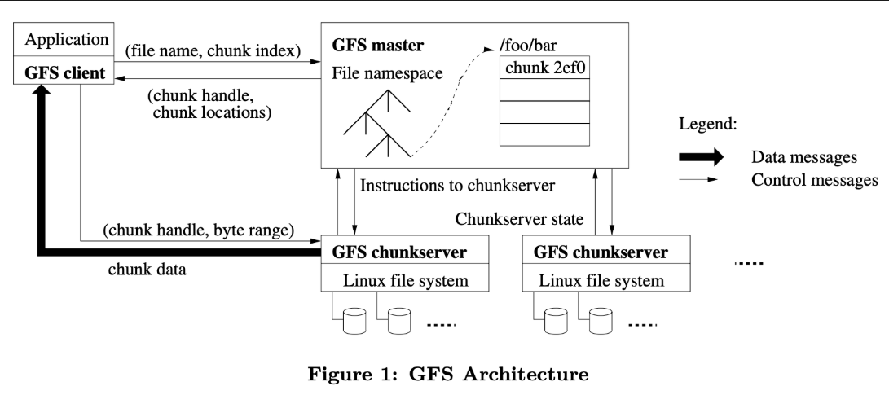
1. GFS (google file system) : -
i) The Google file system (GFS) is designed to manage relatively large files using a very large distributed cluster to commodity servers connected by a high-speed network.
ii) Google File System is another name for GFS.
iii) It manages two types of data namely file data and file metadata.
iv) The GF node cluster consist of a single master and several chunk servers that various client systems regularly access.

Slide 16
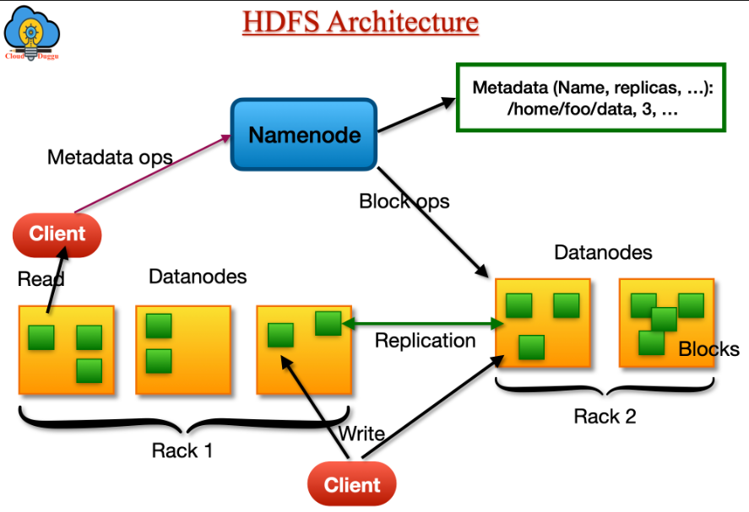
Hdfs (Hadoop distributed file system) : -
i) HDFS is a unique design that provides storage for large files with streaming data access.
ii) It is a open source distributed file system inspired by GFS.
iii) HDFS consist of a single master manages multiple slave nodes that store actual data.
iv) HDFS follows a write-once, read many model, meaning files are typically written once but can be read multiple times.

Slide 17
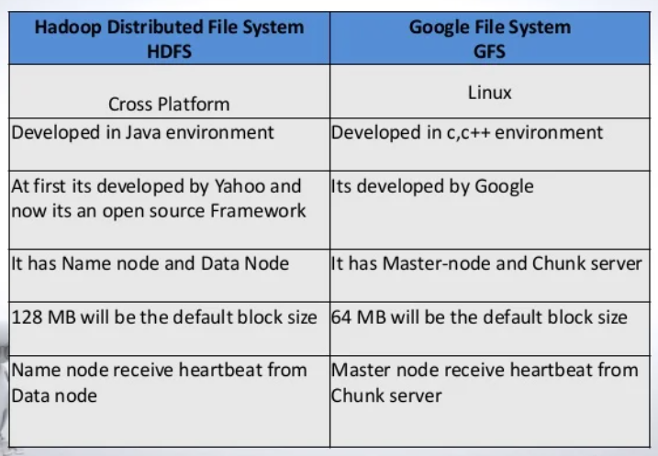
Difference between HDFS & GFD : -

